Slide 1
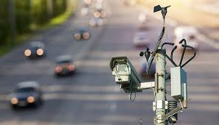
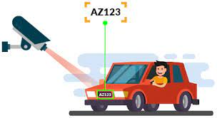
VEHICLE NUMBER PLATE DETECTION
PROJECT UNDER SUPERVISION OF
DR. KOMAL BHATIA
BY DHRUV(19001003039)
BY ASHISH(19001003022)

Slide 2
Introduction
Our project is a system designed which is used to help in the recognition of vehicles . This system is based on the image procession system .This system helps in various function like detection of the number plate of the vehicles and processing them and using the processed data for further processing like storing and allowing vehicles to pass or to reject vehicles

Slide 3
Main task
Our project work on a method that uses optical character recognition om image to read the number plate on vehicles
Our project used to store the image captured by the cameras as well as text from the license plate and also store the photograph of the car
At this time our project usually detect the image but when it is implemented in roads it uses the function that allow the camera to take picture at any time.
It has various other application. It is used in Toll Collection System , Traffic Management System , Border Control ,Parking System.

Slide 4



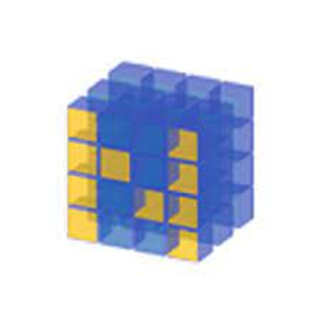


TECHNOLOGIES
PYTHON
Pandas
Open cv
Terresact ocr
Anaconda ,Jypter
Numpy

Slide 5
MODELS
Software
Hardware
Capture the image
Extract the plate from image by converting into different type of image like grayscale image, blur image , filter image,
Recognize the number and convert into string
Camera to capture the image
Pc on which program is executed
Sensors to detect the presence of vehicles

Slide 6
Flow chart
Detect the edges
Contour detection
Insert image
Apply filter
Taken from internet
By using dataset
Sorted the contour
By capturing through camera
Finding information about vehicle using dataset
Final detection of plate

Slide 7
Data Collection
We use the dataset which is used on our project for finding the information of the vehicle. We have use the data from Kaggle which is available on the on Kaggle account of author selvan .We are also making our data which should be very recent and we are also doing work to add the data of all the recent image It contains almost ten thousand image of the number plate which contains various data about any vehicle of the data.

Slide 8
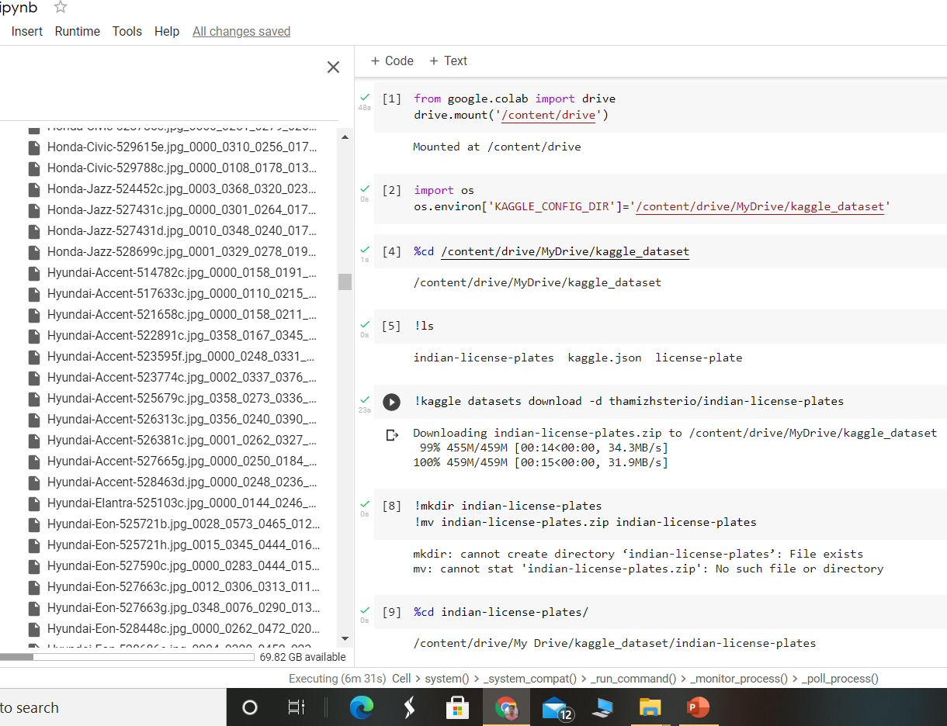
Glance of the dataset

Slide 9
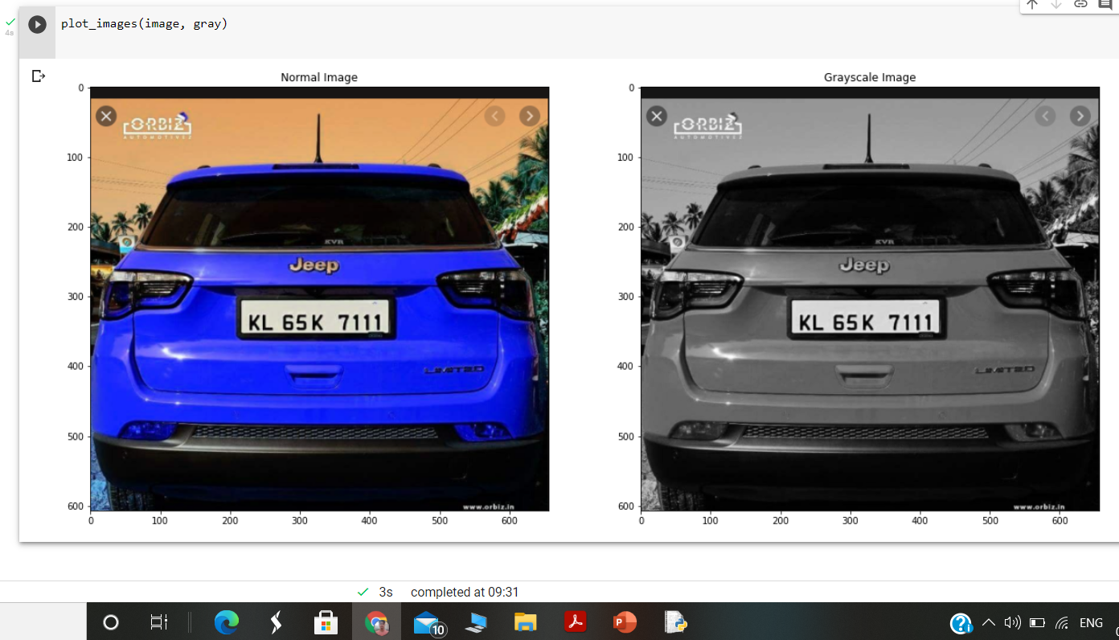
IMPLEMENTATION 1.Convert The Image Into GrayScale Image
Converting into grayscale image speeds up the other process which is implemented in our project later because after removing color we do not have to deal with the color details when we processing an image

Slide 10
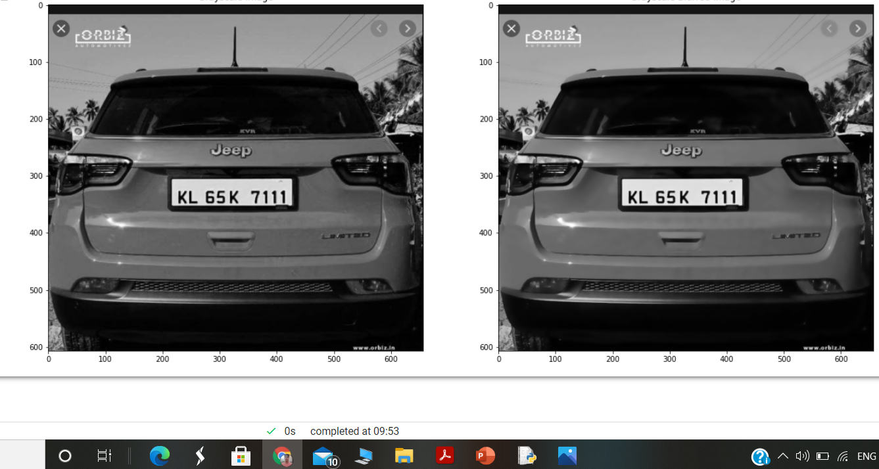
2. Using a bilateral filter
In our project we use the bilateral filter which helps to remove the unwanted detail of the image. By using this our project later on focus only useful regions

Slide 11
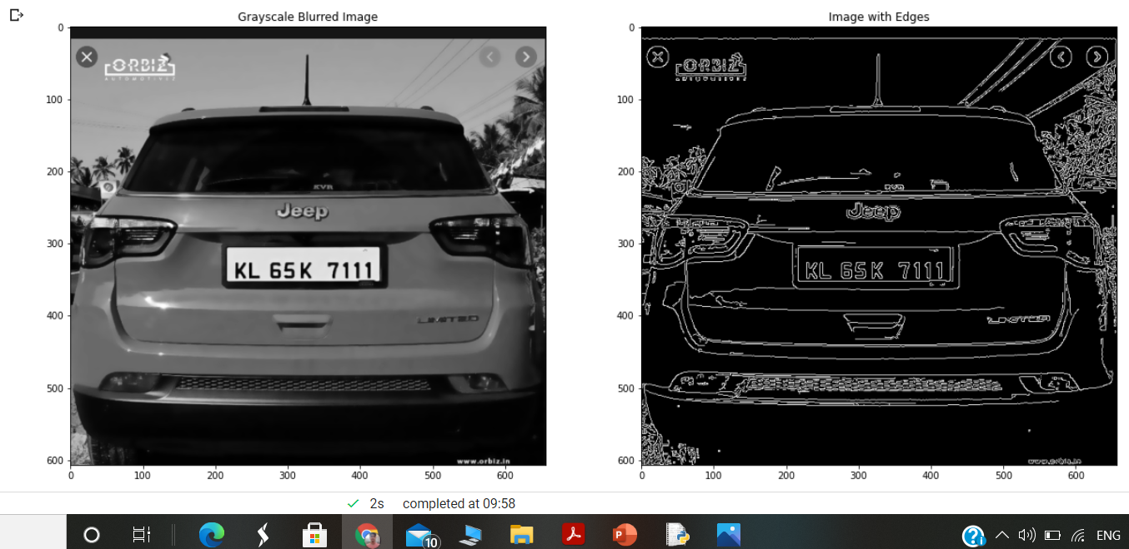
3. Edge detection

Slide 12
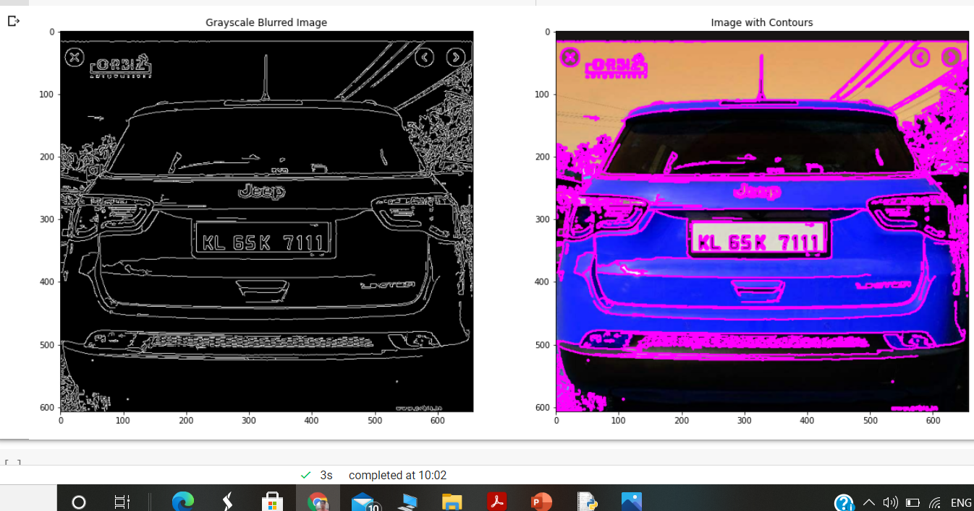
4.Contour detection

Slide 13
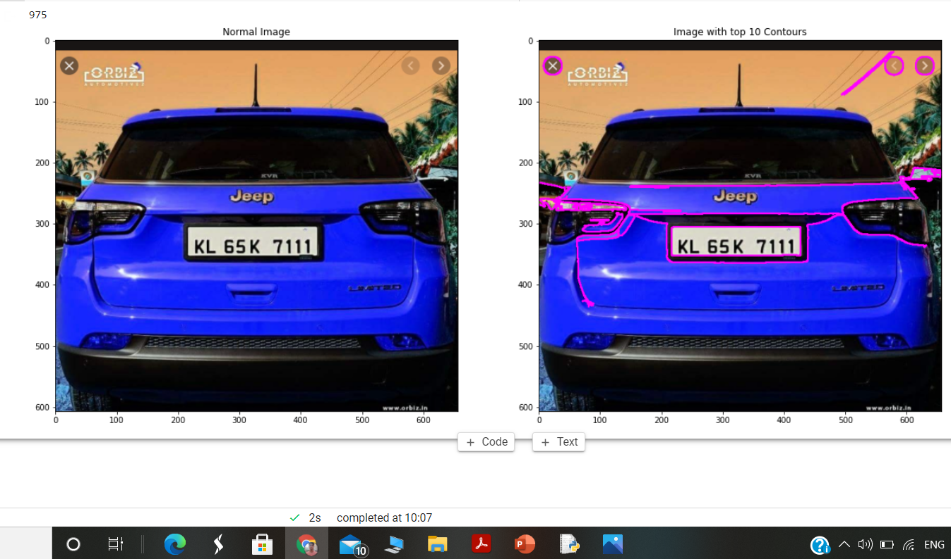
5.Sorted top 10 contours

Slide 14
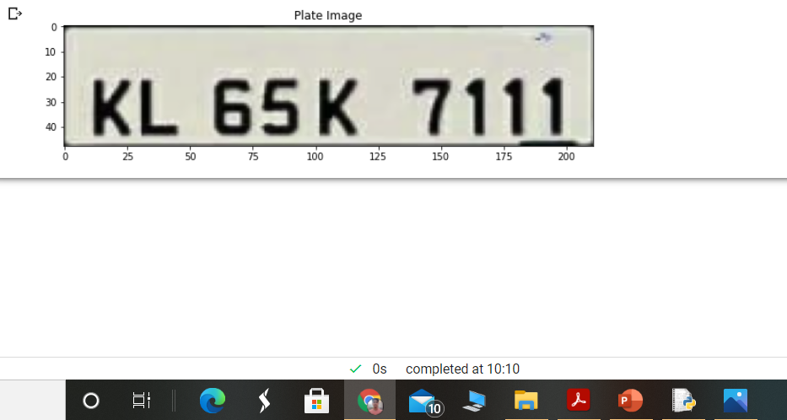
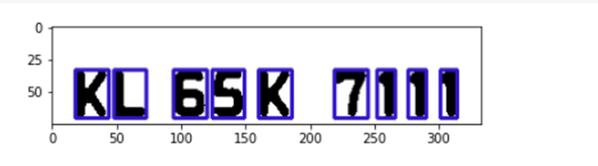

6.Final plate detection

Slide 15
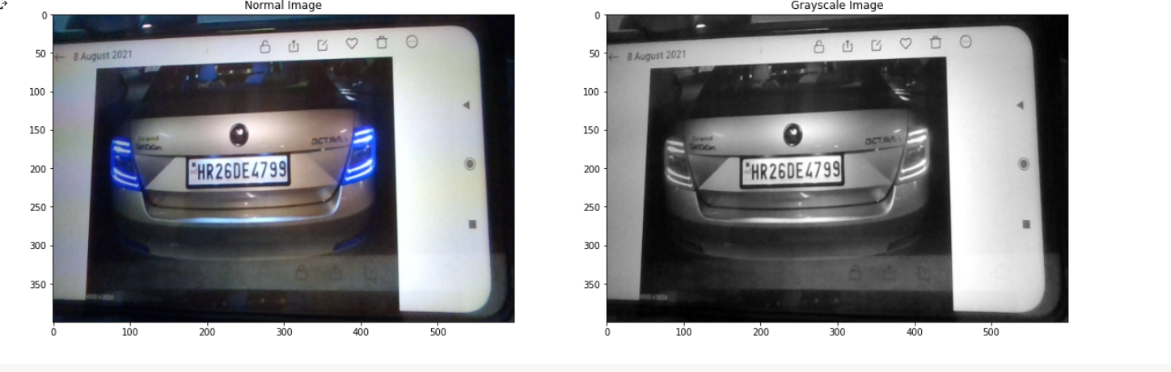
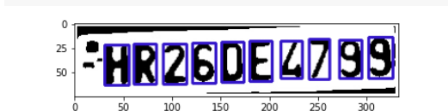
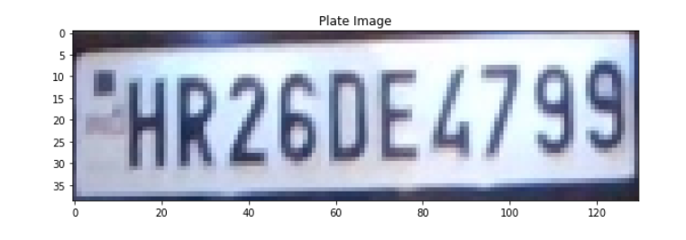

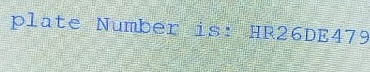
Using image taken by camera

